Slide 1




NEXT GEN EMPLOYABILITY PROGRAM
Creating a future-ready workforce
Team Members
College Name
Student Name :Ashmitha R
Student ID : au960221104033
Arunachala College of Engineering for Women

Slide 2

CAPSTONE PROJECT SHOWCASE
Project Title
Car Rentals Application with Django Framework
Abstract | Problem Statement | Project Overview | Proposed Solution | Technology Used | Modelling & Results | Conclusion

Slide 3
Abstract
This project tackles building a user-friendly car rental application leveraging the power of Django. Django's Model-View-Template (MVT) architecture provides a structured foundation for crafting a database-driven application.
On the backend, Python reigns supreme. It defines models for Cars (encompassing details like make, model, year), Customers (including secure user authentication), and Rentals (capturing booking information). Django's built-in functionalities seamlessly handle user authentication, database interactions, and session management.
For the user interface, HTML takes center stage, designing the web page layout. Frameworks like Bootstrap can be integrated to enhance responsiveness and provide pre-built UI components. Meanwhile, JavaScript libraries like jQuery elevate user interaction and manage dynamic content.
The application empowers users to search for available cars based on filters like type, location, and desired rental dates. Customers can register and login to make reservations, view past rentals, and manage account details. The system calculates rental costs based on car selection and rental duration. This Django-based car rental application offers a robust and user-friendly solution for streamlining the car rental experience.
Source :

Slide 4
Problem Statement
Limited Search Functionality: The current search might only allow filtering by basic criteria like car type and rental dates. How can we improve the search experience to include more advanced filters like price range, features (sunroof, GPS, etc.), and fuel efficiency?
Inventory Management: The system might not handle car availability in real-time. How can we implement a system to prevent double-booking cars and ensure accurate inventory reflection?
Integration with Payment Gateways: Currently, the application might not accept online payments. How can we integrate secure payment gateways to allow users to seamlessly pay for rentals during the booking process?
Lack of User Reviews and Ratings: The application might not have a feature for users to leave reviews and ratings for their rental experience. How can we incorporate a user feedback system to improve transparency and trust for future renters?
Mobile App Development: The application might only be accessible through a web browser. How can we expand functionality by developing a mobile application for users to manage rentals and access features on the go?
Source :

Slide 5
Project Overview
This project builds a user-friendly car rental app with Django. Django's structure facilitates managing cars, customers, and bookings.
Target: Customers seeking car rentals.
Features:
Manage cars (details, images, availability) in Django admin.
Secure user accounts with login and profiles (HTML forms).
Search cars with advanced filters (HTML forms, JS validation).
Make online reservations with clear pricing (Python logic).
Enhanced UI:
Responsive design with HTML, CSS, and Bootstrap.
Interactive features using JavaScript libraries.
Deliverables:
Functional web app with user interface.
Secure backend (Django) for authentication, database, and rentals.
Clear documentation.
Challenges:
Real-time car availability.
Secure payment gateway integration (future).
This project offers a user-friendly solution for car rentals.
Source :

Slide 6
Proposed Solution
Integrate search filters using HTML forms with options for price range, features (checkboxes), and fuel efficiency (dropdown menu). Utilize JavaScript libraries for dynamic filtering and result updates.
Implement a car reservation system within Django. Upon booking confirmation, update car availability in real-time to prevent double bookings. Leverage Django signals to trigger updates whenever a reservation is made or modified.
Utilize Bootstrap for a responsive design that adapts to various screen sizes. Integrate JavaScript libraries like jQuery to create interactive features:
Car image carousels for showcasing multiple car images.
In-line validation to provide immediate feedback during form filling (e.g., ensuring valid dates).
Interactive calendars for selecting rental dates with date pickers.
Partner with a secure payment gateway service like Stripe or PayPal. Integrate their API into the Django application to handle online payments during the booking process. Ensure a secure connection for sensitive financial information.
Enhance the existing web application using responsive design principles with CSS media queries to optimize the layout and functionality for mobile devices.
For a dedicated mobile experience, create a separate mobile application using frameworks like React Native or Flutter that can access the same backend data as the web application.
Source :

Slide 7


Technology Used
Front-end
Back-end
Source :

Slide 8
Modelling & Results
Our car rental app uses Django models to represent real-world things:
Cars: details like make, year, features, price per day, and an image.
Customers: username, password (securely stored), name, email, and driver's license (optional).
Rentals: link a car to a customer, with start/end dates and total price (based on daily rate and duration).
These models connect: a Car can have many Rentals, and a Customer can have many Rentals (think renting multiple cars). This structure lays the groundwork for features like car search, booking, and managing rental details.
The Python Django car rental app delivers a user-friendly platform:
Easy Car Management: Owners add/edit car details (make, features, images, pricing) through the Django admin.
Secure Customer Accounts: Users register and login securely, managing profiles and rental history.
Advanced Search: Customers filter cars by type, location, dates, price, and features.
Online Booking: Users make online reservations with clear pricing based on chosen car and rental duration.
Responsive Interface: HTML, CSS, and Bootstrap ensure a smooth experience across devices.
This user-friendly and feature-rich platform benefits both car rental agencies (efficient management) and customers (streamlined rentals).
Source :

Slide 9
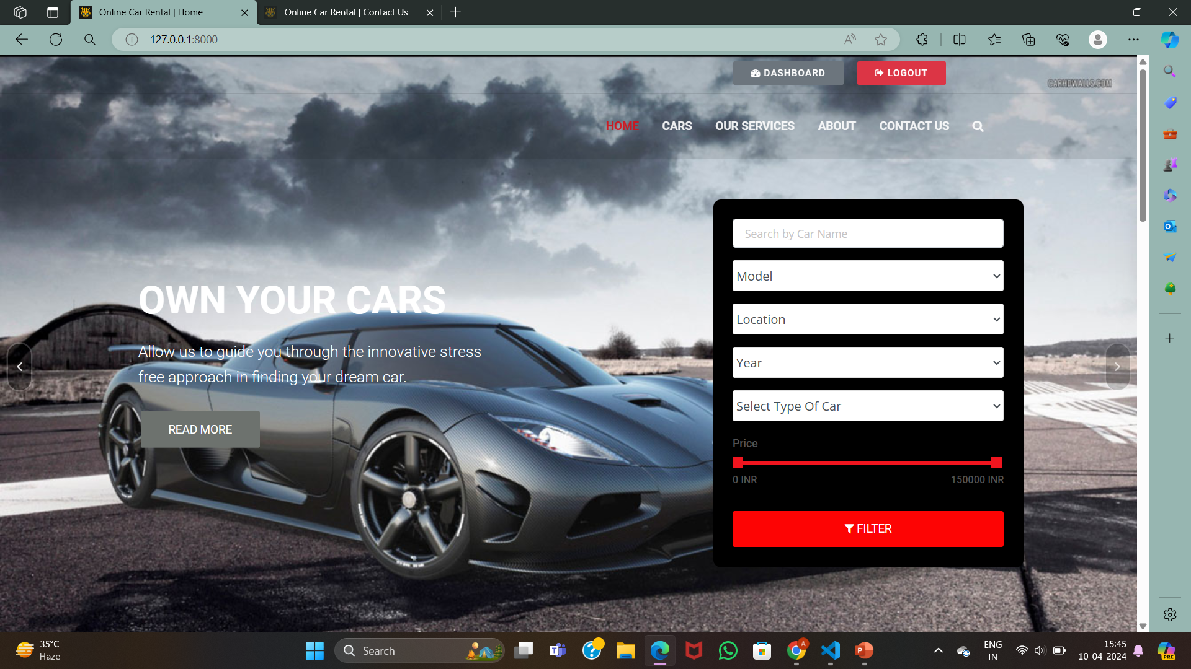
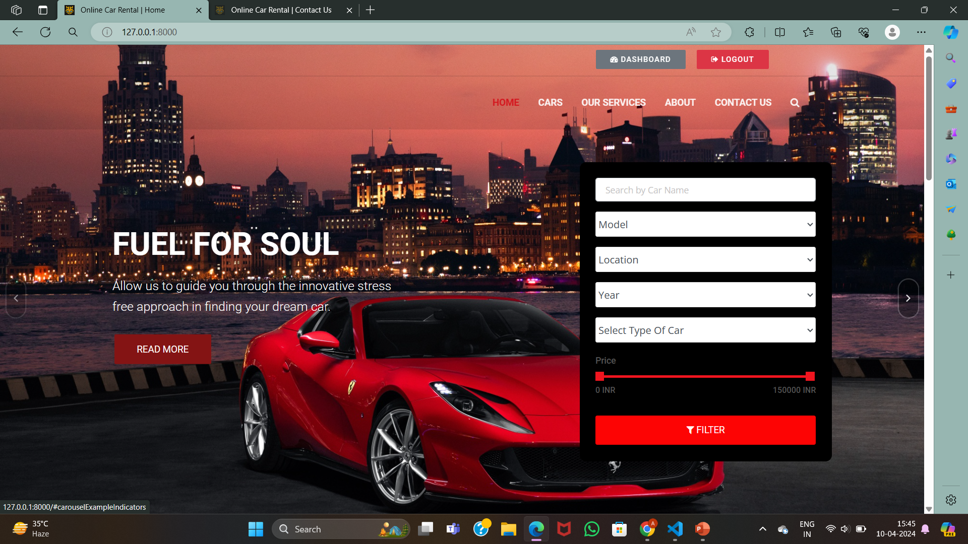
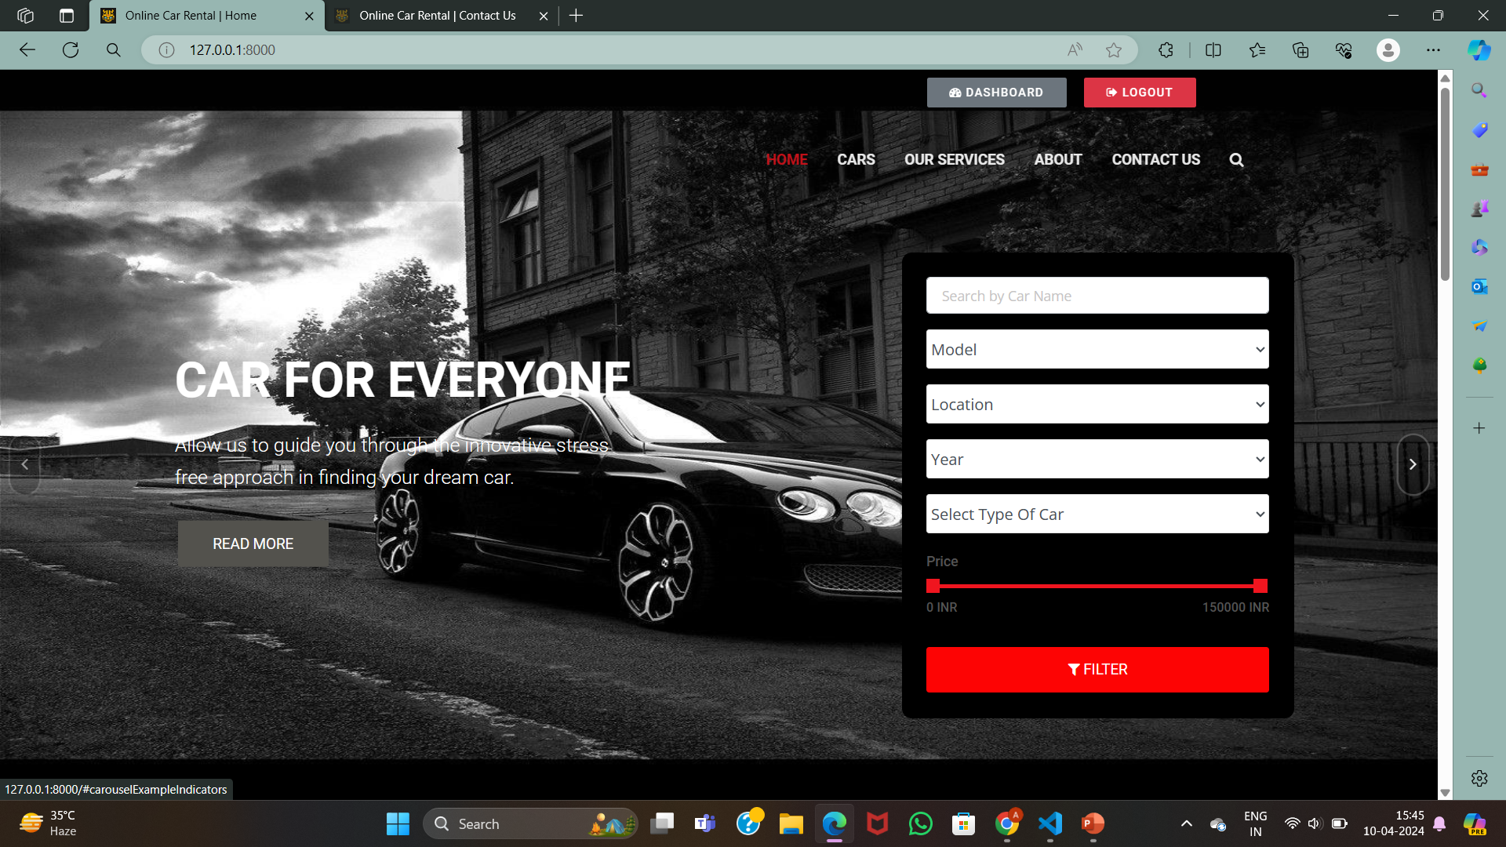
Homepage

Slide 10
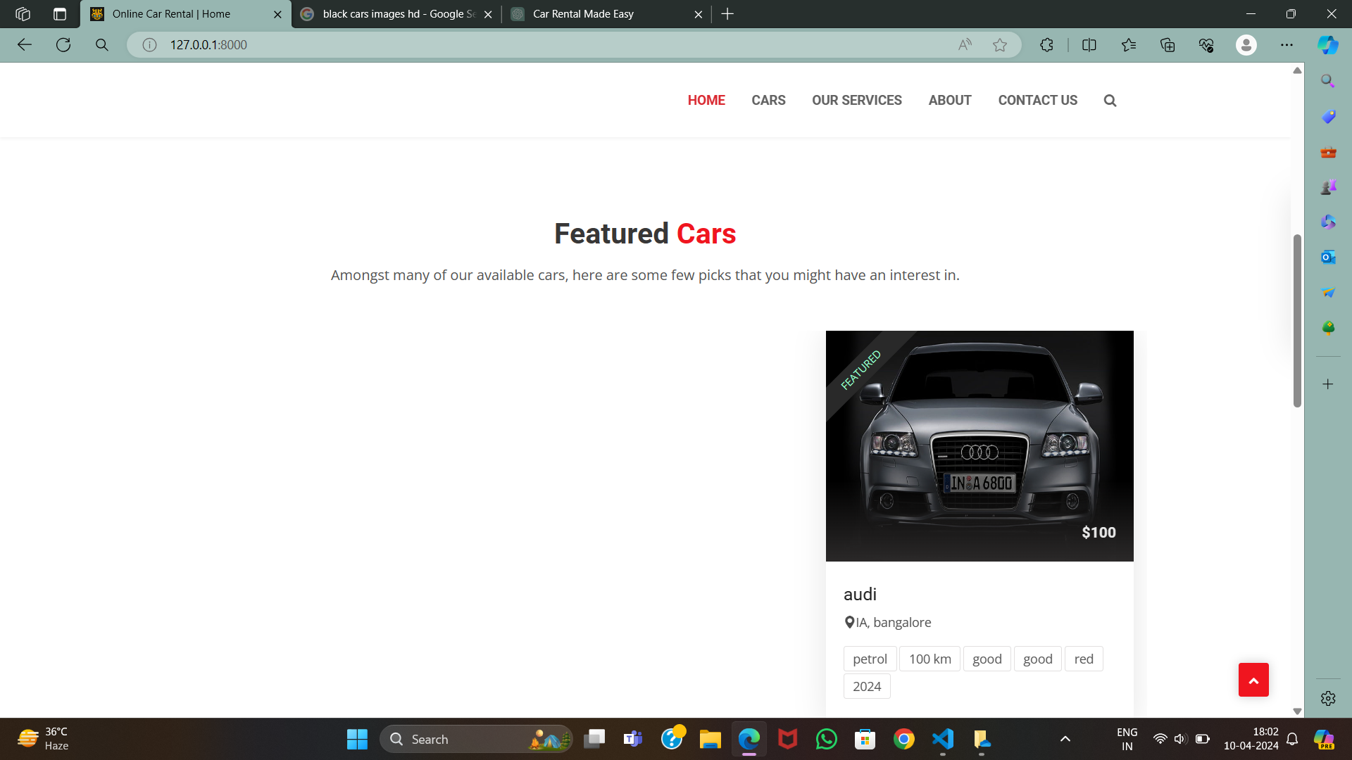
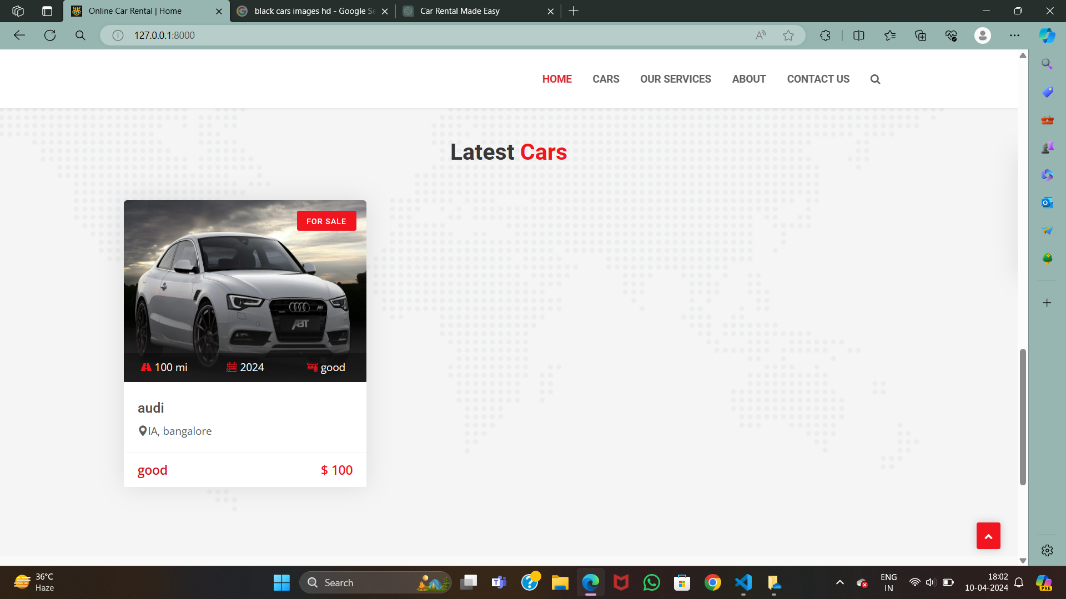
Home Page

Slide 11
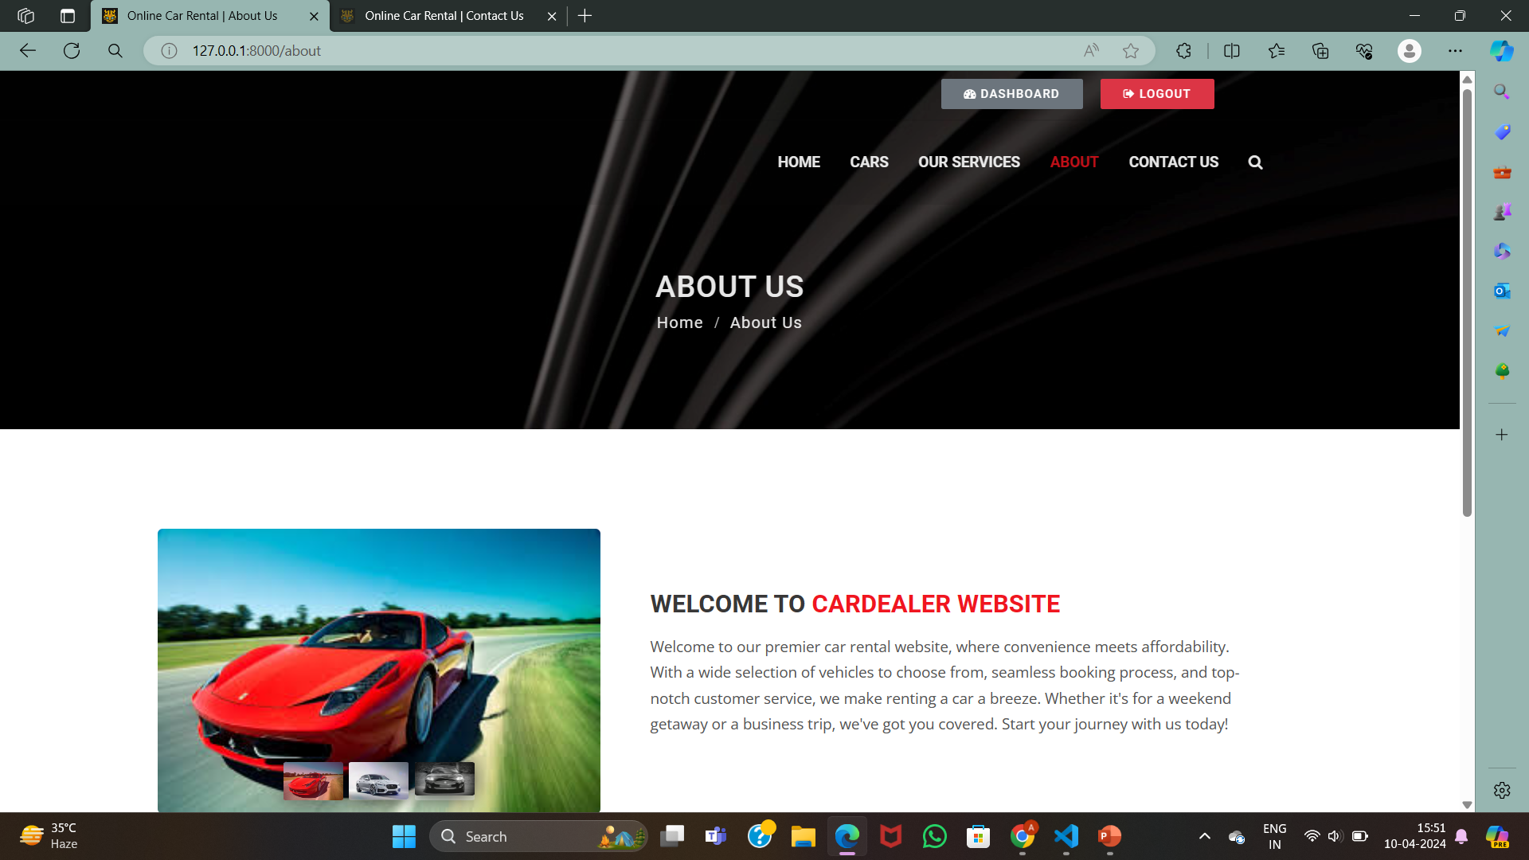
About-Us-Page

Slide 12
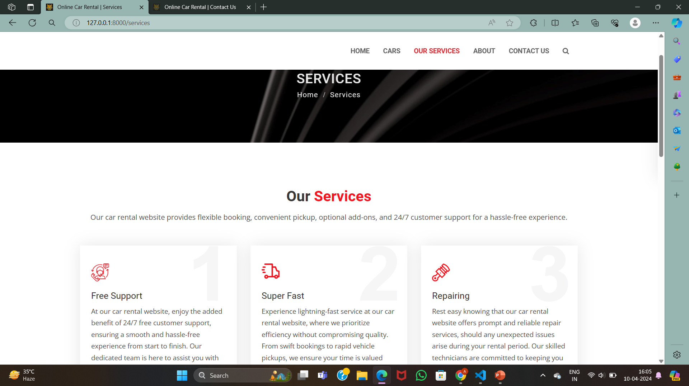
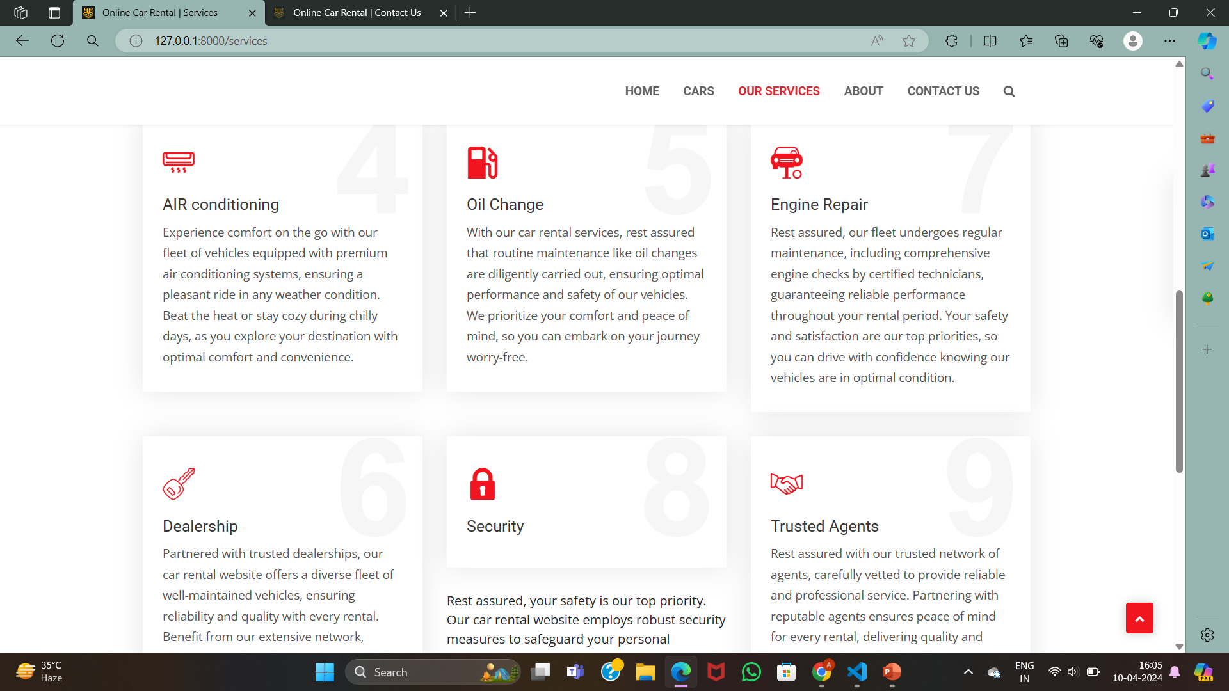
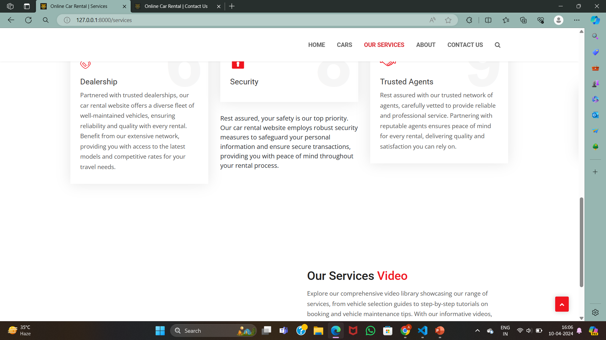
Service-Page

Slide 13
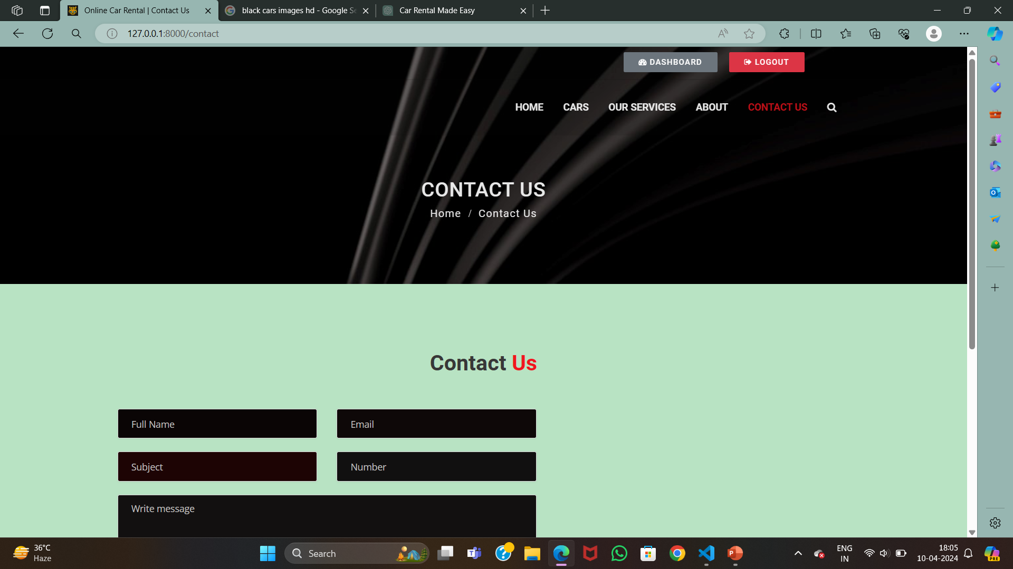
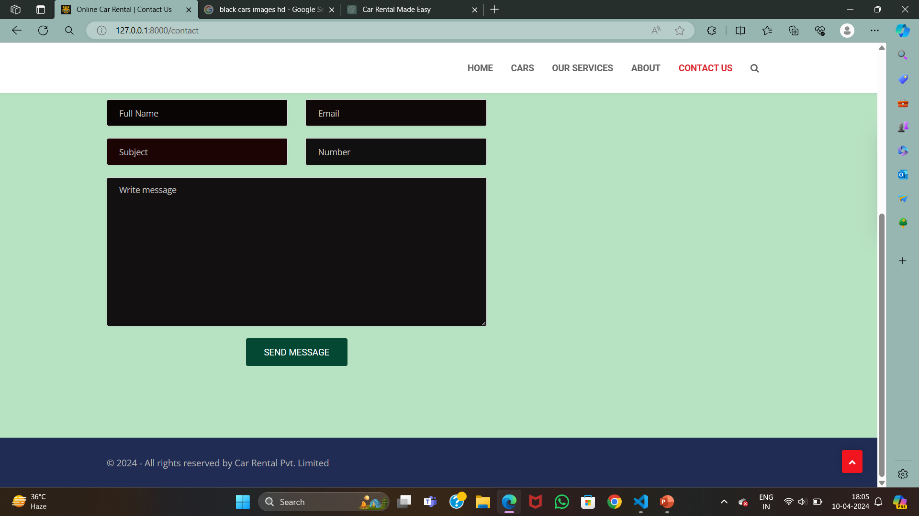
Contact us page

Slide 14
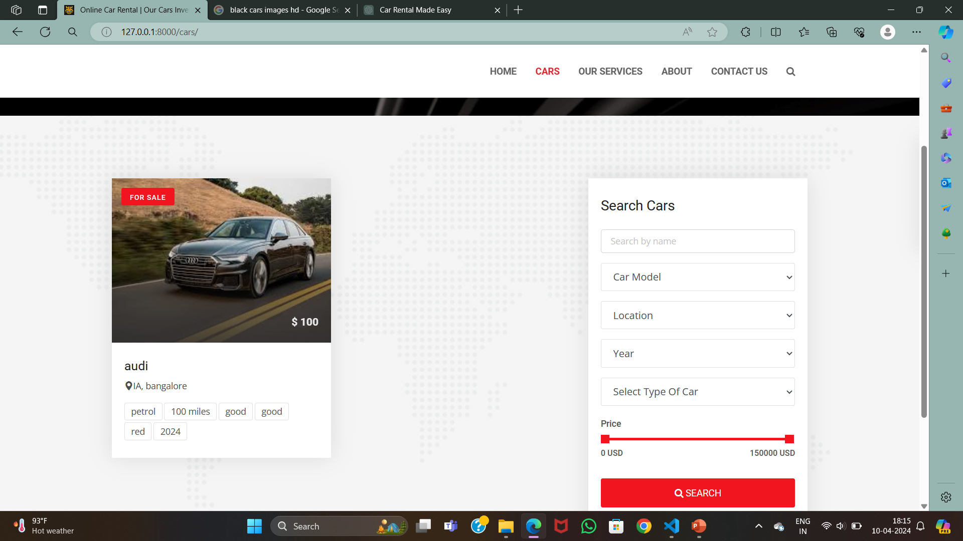
Cars Page

Slide 15
Future Enhancements:
In our roadmap for enhancing the car rental web application using Django, we aim to integrate real-time vehicle tracking, ensuring heightened security and peace of mind for renters. Additionally, personalized recommendation systems will analyze user preferences and past rentals to suggest ideal vehicle options. The seamless integration of mobile payment solutions will streamline the booking process, allowing for quick and secure transactions on the go. Furthermore, AI-powered chatbots will provide instant support and assistance, enhancing customer satisfaction and resolving queries efficiently. These advancements collectively aim to elevate the user experience, making car rental more convenient, secure, and personalized.

Slide 16
Conclusion
In conclusion, the utilization of the Django framework has empowered our car rental web application with robust capabilities, ensuring a seamless and user-friendly experience for our customers. Through real-time vehicle tracking, personalized recommendation systems, seamless mobile payment integration, and AI-powered chatbots, we've enhanced every aspect of the rental process. These features not only streamline booking and payment but also prioritize security, convenience, and customer satisfaction. By leveraging Django's flexibility and scalability, we've built a platform that adapts to the evolving needs of our users, providing them with a cutting-edge solution for their car rental needs. As we continue to innovate and expand our offerings, our commitment remains steadfast in delivering excellence in service and technology, making renting a car an effortless and enjoyable experience for all.
Source :

Slide 17
Thank You!
Notes:
Thank You !!

